Slide 1
Inner Classes

Slide 2

Inner classes are classes defined within other classes
  The class that includes the inner class is called the outer class
  There is no particular location where the definition of the inner class (or classes) must be place within the outer class
  Placing it first or last, however, will guarantee that it is easy to find

Slide 3
An inner class definition is a member of the outer class in the same way that the instance variables and methods of the outer class are members
  An inner class is local to the outer class definition
  The name of an inner class may be reused for something else outside the outer class definition
  If the inner class is private, then the inner class cannot be accessed by name outside the definition of the outer class

Slide 4

public class Outer
{
private class Inner
{
// inner class instance variables
// inner class methods
} // end of inner class definition
// outer class instance variables
// outer class methods
}

Slide 5
There are two main advantages to inner classes
  They can make the outer class more self-contained since they are defined inside a class
  Both of their methods have access to each other's private methods and instance variables
Using an inner class as a helping class is one of the most useful applications of inner classes
  If used as a helping class, an inner class should be marked private

Slide 6

Within the definition of a method of an inner class:
  It is legal to reference a private instance variable of the outer class
  It is legal to invoke a private method of the outer class
  Essentially, the inner class has a hidden reference to the outer class
Within the definition of a method of the outer class
  It is legal to reference a private instance variable of the inner class on an object of the inner class
  It is legal to invoke a (nonstatic) method of the inner class as long as an object of the inner class is used as a calling object
Within the definition of the inner or outer classes, the modifiers public and private are equivalent

Slide 7

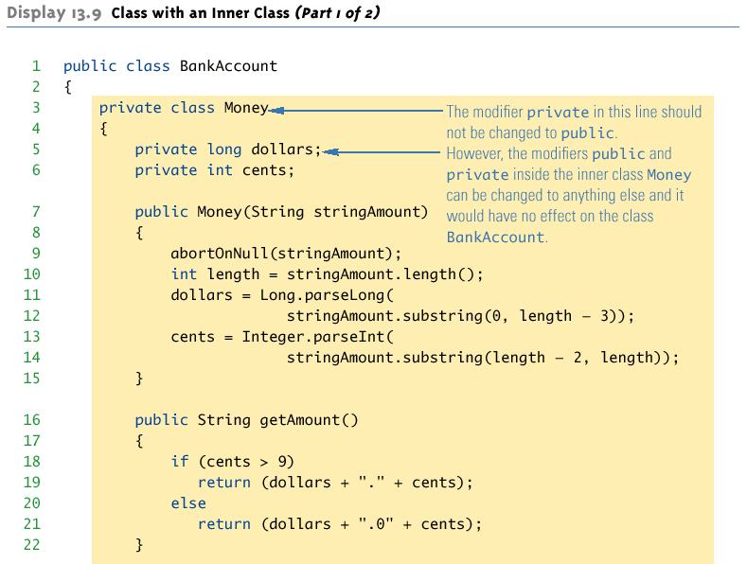

Slide 8

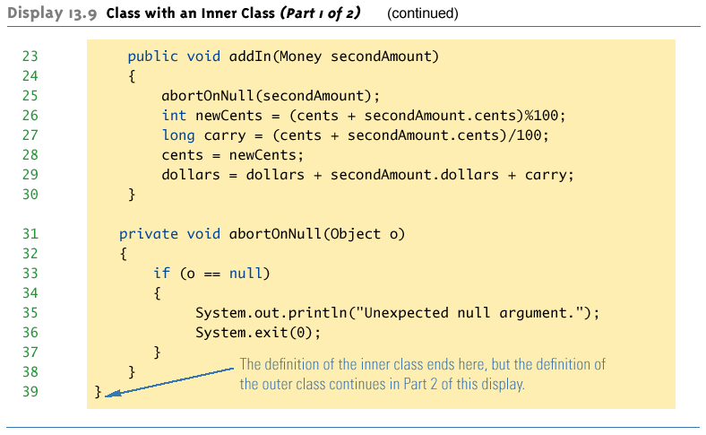

Slide 9

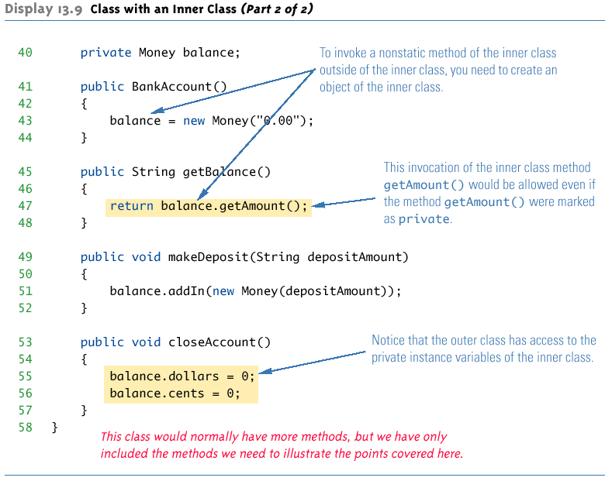

Slide 10
If a method is invoked in an inner class
  If the inner class has no such method, then it is assumed to be an invocation of the method of that name in the outer class
  If both the inner and outer class have a method with the same name, then it is assumed to be an invocation of the method in the inner class
  If both the inner and outer class have a method with the same name, and the intent is to invoke the method in the outer class, then the following invocation must be used:
    OuterClassName.this.methodName()

Slide 11

If an inner class is marked public, then it can be used outside of the outer class
In the case of a nonstatic inner class, it must be created using an object of the outer class
    BankAccount account = new BankAccount();
    BankAccount.Money amount =
    account.new Money("41.99");
  Note that the prefix account. must come before new
  The new object amount can now invoke methods from the inner class, but only from the inner class

Slide 12
In the case of a static nested class, the procedure is similar to, but simpler than, that for nonstatic inner classes
    OuterClass.InnerClass innerObject =
    new OuterClass.InnerClass();
  Note that all of the following are acceptable
    innerObject.nonstaticMethod();
    innerObject.staticMethod();
    OuterClass.InnerClass.staticMethod();

Slide 13

If the Money inner class in the BankAccount example was defined as public, we can create and use objects of type Money outside the BankAccount class.
// this is okay in main( )
BankAccount account = new BankAccount( );
BankAccount.Money amt = // note syntax
account.new Money( “41.99” );
System.out.println( amt.getAmount( ) );
// but NOT this – why not??
System.out.println( amt.getBalance( ) );
Notes:
amt.getBalance( ) is illegal because getBalance( ) is a method of BankAccount, not Money

Slide 14

A normal inner class has a connection between its objects and the outer class object that created the inner class object
  This allows an inner class definition to reference an instance variable, or invoke a method of the outer class
There are certain situations, however, when an inner class must be static
  If an object of the inner class is created within a static method of the outer class
  If the inner class must have static members

Slide 15
Since a static inner class has no connection to an object of the outer class, within an inner class method
  Instance variables of the outer class cannot be referenced
  Nonstatic methods of the outer class cannot be invoked
To invoke a static method or to name a static variable of a static inner class within the outer class, preface each with the name of the inner class and a dot

Slide 16

A class can have as many inner classes as it needs.
Inner classes have access to each other’s private members as long as an object of the other inner class is used as the calling object.

Slide 17

Compiling any class in Java produces a .class file named ClassName.class
Compiling a class with one (or more) inner classes causes both (or more) classes to be compiled, and produces two (or more) .class files
  Such as ClassName.class and ClassName$InnerClassName.class

Slide 18

It is legal to nest inner classes within inner classes
  The rules are the same as before, but the names get longer
  Given class A, which has public inner class B, which has public inner class C, then the following is valid:
    A aObject = new A();
    A.B bObject = aObject.new B();
    A.B.C cObject = bObject.new C();

Slide 19

Given an OuterClass that has an InnerClass
  Any DerivedClass of OuterClass will automatically have InnerClass as an inner class
  In this case, the DerivedClass cannot override the InnerClass
An outer class can be a derived class
An inner class can be a derived class also

Slide 20

Local classes are classes that are defined in a block, which is a group of zero or more statements between balanced braces. You typically find local classes defined in the body of a method.

Slide 21

You can define a local class inside any block (see Expressions, Statements, and Blocks for more information). For example, you can define a local class in a method body, a for loop, or an if clause.
The following example:
LocalClassExample, validates two phone numbers. It defines the local class PhoneNumber in the method validatePhoneNumber:

Slide 22

If an object is to be created, but there is no need to name the object's class, then an anonymous class definition can be used
  The class definition is embedded inside the expression with the new operator
  An anonymous class is an abbreviated notation for creating a simple local object "in-line" within any expression, simply by wrapping the desired code in a "new" expression.
Anonymous classes are sometimes used when they are to be assigned to a variable of another type
  The other type must be such that an object of the anonymous class is also an object of the other type
  The other type is usually a Java interface
  Not every inner class should be anonymous, but very simple "one-shot" local objects are such a common case that they merit some syntactic sugar.

Slide 23
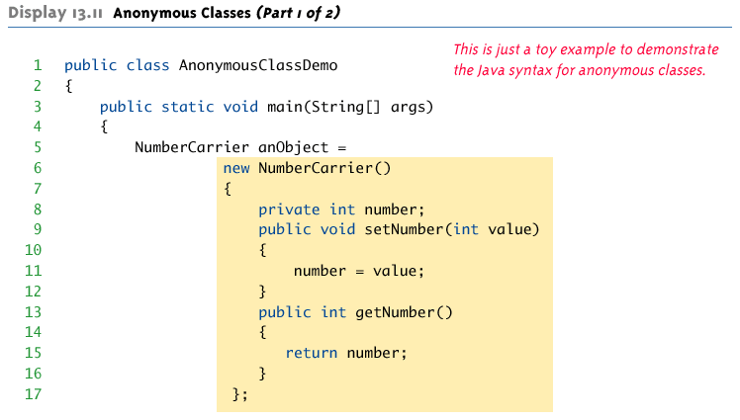

Slide 24

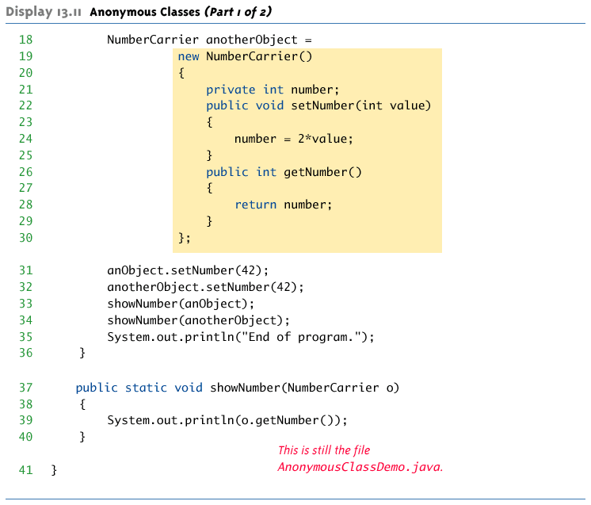

Slide 25



